Slide 1
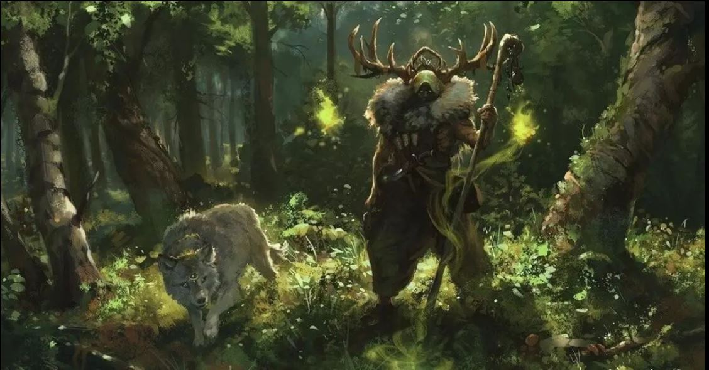
Sprint Review
team 4 - Agile dungeon trekking
CSCI E-71 December 2022
Notes:
Your Scrum Master facilitates as needed: keeps track of time, prompts your PO and Developers at the right moments, etc.

Slide 2
WELCOME
What did we accomplish in this Sprint?
What changed in our environment?
What do we do next?
What progress did we make towards the Product Goal?
“The purpose of the Sprint Review is to inspect the outcome of the Sprint and determine future adaptations. The Scrum Team presents the results of their work to key stakeholders and progress toward the Product Goal is discussed.”
–The 2020 Scrum Guide
your scrum team
Diana Liu
Mike Reekie
Kelly Robertson
drew Fitzgerald
Notes:
Your PO begins the sprint review by stating its purpose. You welcome your stakeholders to the event, tell them how grateful you are for their participation, and that you're eager to hear their feedback after you show them the product increment.

Slide 3
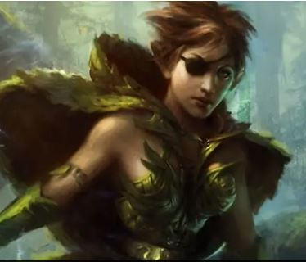
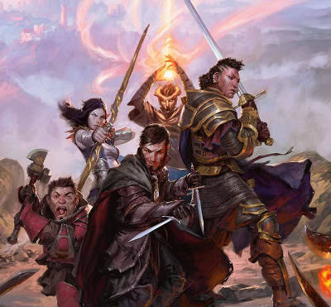
agile dungeon trekking application
Near Vision
Far Vision
Play better together even when you are far away - Improve gameplay and collaboration for teams playing in person or online across multiple campaigns and player characters
Play better together - Improve game play for team members playing as a single team running a campaign
Notes:
Your Product Owner explains your product's far vision and near vision. You use big visible information radiators (e.g., posters or a slide deck) to facilitate your stakeholders' ability to follow along.

Slide 4
STAKEHOLDERS & USERS
User Persona:
Name: Lexi Player One (real person)
Role: Player in a team campaign, Beginner player
Age: 12
Computer Skills: Word, Excel, PowerPoint, Google suite, internet browsers
Apps Currently Used: TikTok, Instagram, You Tube
D&D Skills: playing in first campaign
Motivation: have fun, role play a Druid character
Desires/wants/needs: Change into animals, make friends with NPC animals
Stakeholder Types:
Dungeon Master
Player in a team/campaign
Player looking for a team/campaign
Experienced player (> 1 yr playing)
Inexperienced or beginner player ( < 1 yr playing)
Notes:
Your PO describes your stakeholders and user personas. You use big visible information radiators (e.g., posters or a slide deck) to facilitate your stakeholders' ability to follow along.

Slide 5
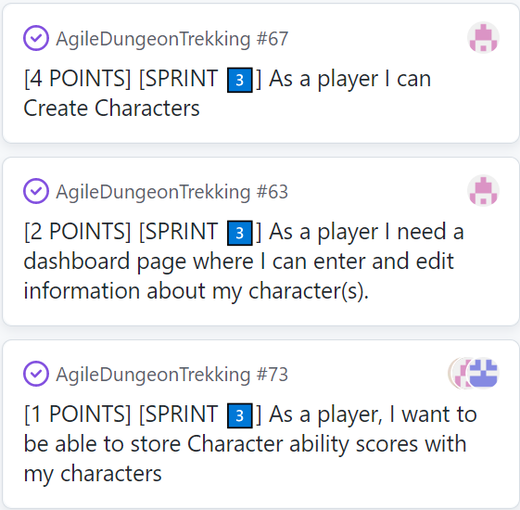
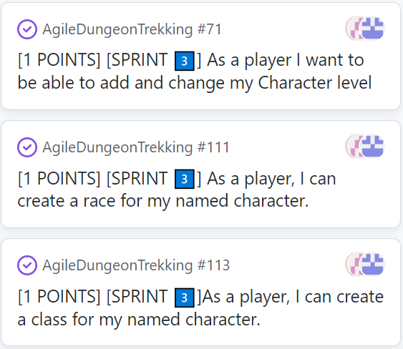
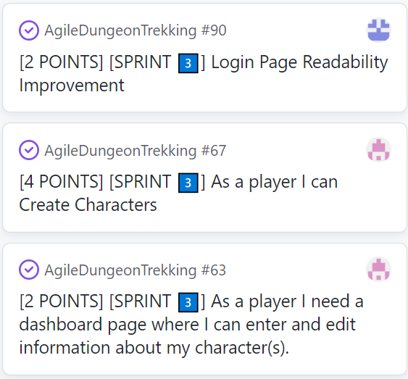
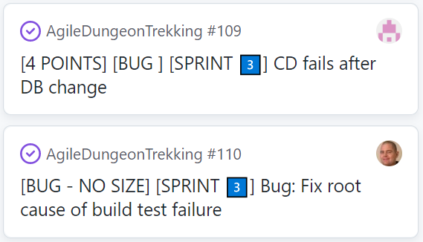
PRODUCT DEMONSTRATION
Product Backlog Items Completed in sprint 3
14 points
Notes:
Your Developers demonstrate your product increment. You demonstrate each product backlog item that you completed. You use big visible information radiators (e.g., your sprint backlog with details of the user stories) to facilitate your stakeholders' ability to follow along. Your product increment is working software.
63 Character Sheets: Each character I create should have it's own dashboard. I need to keep track of this information because as my level, hit points, ability scores and armor class increase my character gets more powerful.
67 Character Name: I need to choose a unique name for my character. My name may reflect my backstory, my family, my race or my class.
73 Character ability scores: I need this information so I know how well my character can resist magical attacks and do certain tasks.
71 Character level: I need this information, so I know which abilities, attacks, spells and feats are available to my character.
113 Character Class: My choice of class describes the primary progression of abilities that exist throughout my character’s adventuring career.
111 Character Race: My choice of race establishes fundamental qualities that exist throughout my character’s adventuring career.
109 CD fails after DB change:
Description: The app deployment is failing. Using the logs and discussing the timeline, we are fairly certain that:
Context: This is related to the storing of photos in the database. Support for this required the transition from Sqlite to postgres. We have been having deployment issues since then. There is a strong correlation between the change in the db technology and the issues
Our plan of attack:
Any code/Database changes are rolled back to the working version
Any settings changes are rolled back to the working version
re-introduce changes to locate the break.

Slide 6
break for demo

Slide 7
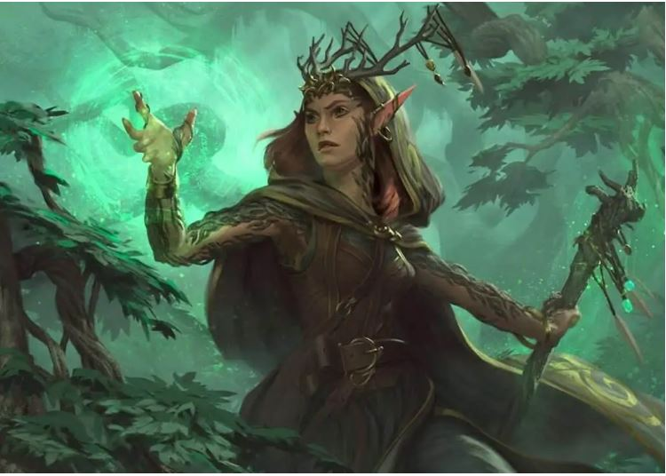
fEEDBACK
What questions does the team have?
What works?
What doesn’t work?
Do we need to make adjustments?
Are we on track for our next release?
we use your feedback to revise our product backlog
Notes:
Your PO solicits feedback from your stakeholders (using class attendees as stand-ins). You ask them what they would like the next product increment to contain, now that they've seen this increment. You revise your product backlog based on the feedback you receive.

Slide 8
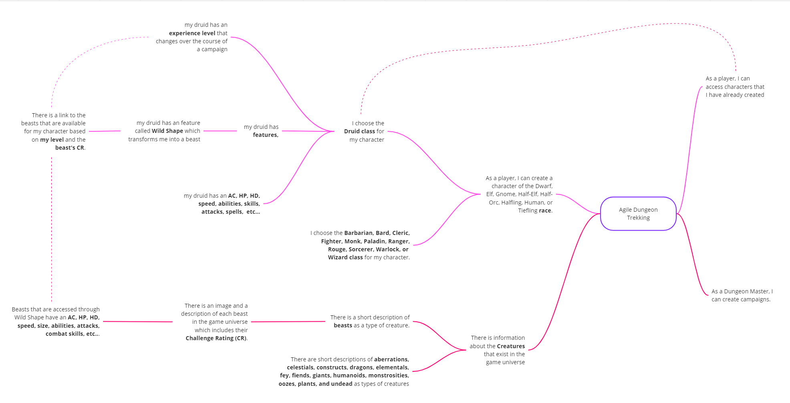
Mind Map of future True User Stories
8 branches
11 branches
Druid Branch
Beasts Branch
Wild Shape Feature
13 branches
Notes:
Your PO shares future plans for your product.

Slide 9
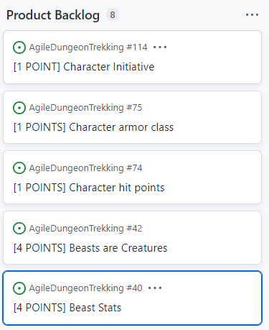
SPRINT 4 FORECAST
Continue building the character sheet template in the player’s dashboard
Initiative
Armor class
Hit Points
Introduce beasts as a type of creature that the players will encounter
Provide additional details for the beasts that can be used for Wild Shape
11 points
Notes:
Your PO wraps up the sprint review with a forecast of what you might deliver in the next sprint (pretend there will be a next sprint), a brief summary of this sprint review, and a message of gratitude to your Scrum team and stakeholders.

Slide 10
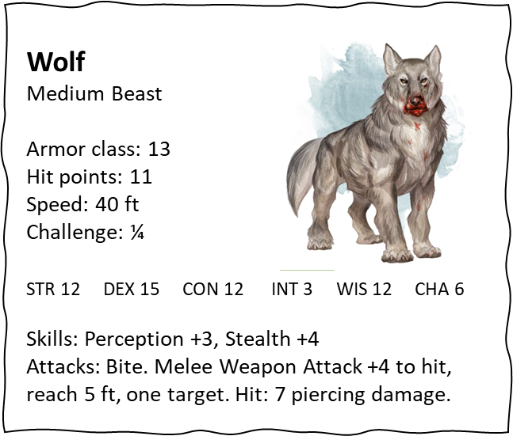
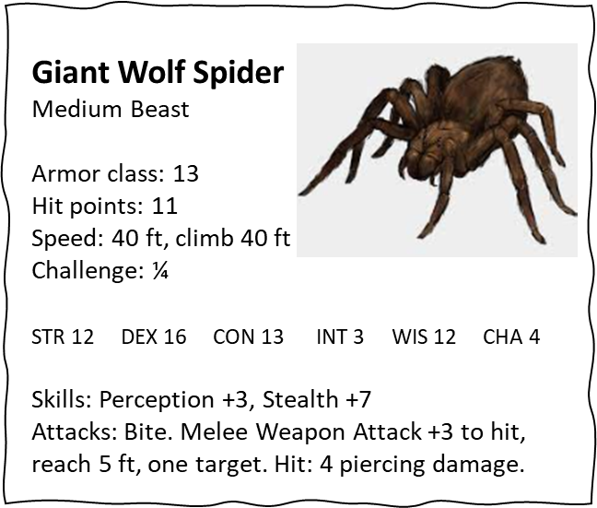
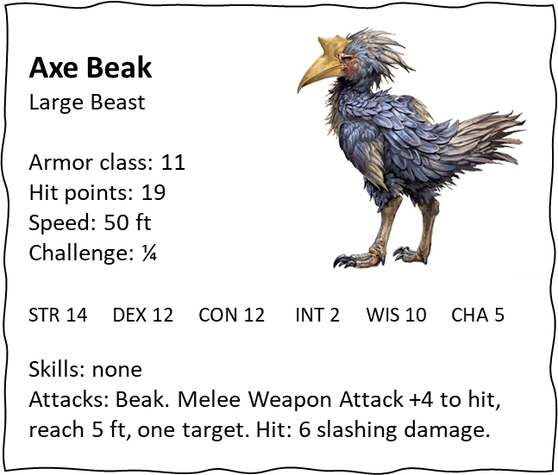
sneak peek

Slide 11
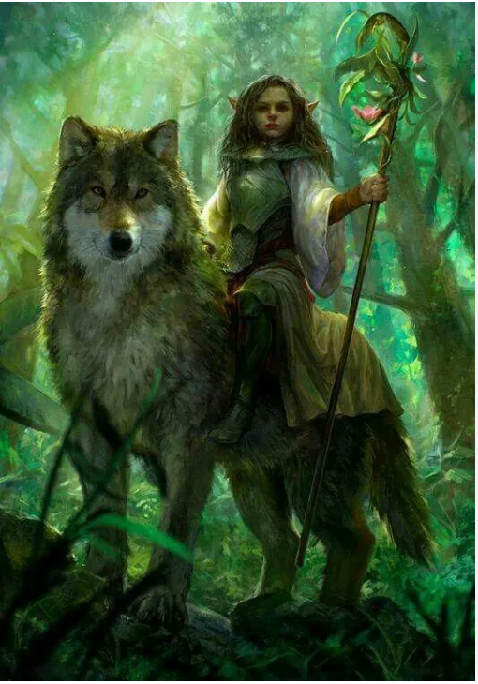
Thank You, stakeholders & scrum team!
the AGILE Dungeon trekkers
Diana Liu
Mike Reekie
Kelly Robertson
drew Fitzgerald
Notes:
and a message of gratitude to your Scrum team and stakeholders.

Slide 12
back-up charts

Slide 13
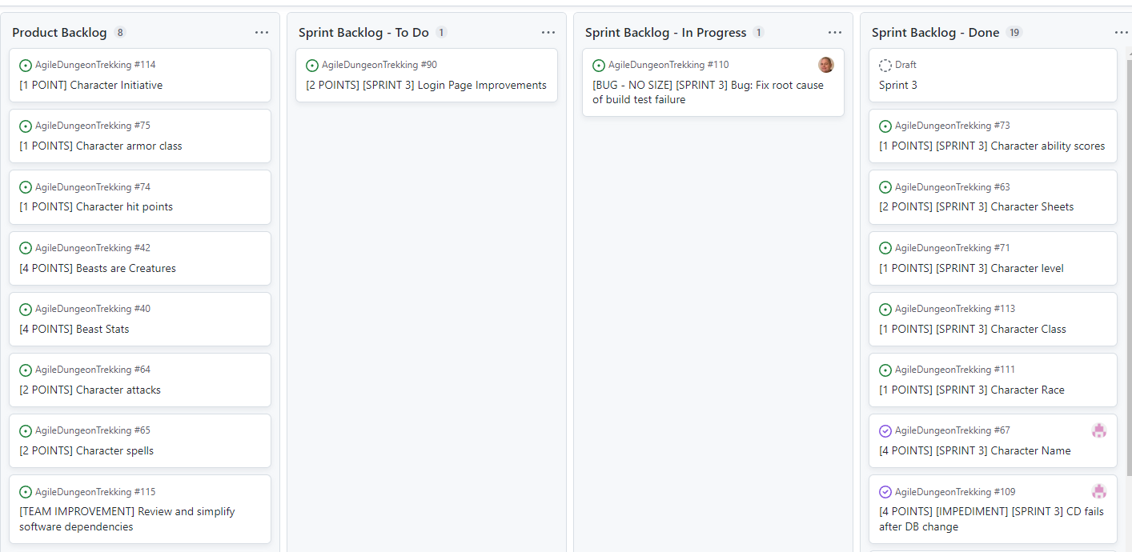

Slide 14
